Slide 1
Kings of Dominia
Alexander Schuster, Mengdi Wang ,
Mohamed Haddej, Alexander Epple

Slide 2
Game Overview
Titel: Kings of Dominia
Platform: Android/iOS & Windows
Genre: Puzzle / Strategy
Rating: FSK 0
Target: Casual Gamer
Kings of Dominia is a puzzle game where you place Domino stones strategically in order to bring the enemy to fall. There are mutiple levels and stone types to achieve this goal.

Slide 3
High Concept & Unique Selling Points
High Concept:
Kings of Dominia takes place in a medieval world where the player is in control of a Domino army.
The player tries to storm castles of enemy kings by placing Domino rows and using upgrade stones.
Blast, slide and fall through a variety of levels and bring glory to your kingdom.
Unique Selling Points:
Multiplatform support (Android/iOS/Windows)
Unique concept (modern Domino game)
Easly expandable (free/paid DLCs)

Slide 4
Game Objectives & Game Rules
Goal:
Bring the enemy king to fall by placing Domino rows and using upgrades strategically
Rules:
Place unlimited normal stones on flat surfaces
Upgrade a limited amount of placed stones
Start the attempt knocking over your king
Use cannons and gates by letting a stone fall on the respective activation pad

Slide 5
Game Controls
Turn and move the camera with two fingers
Switch between the view and edit mode by clicking the respective button
Place Domino rows by drawing on the level
Upgrade a Domino by holding down on it
Turn cannons by holding down on them
Start the attempt by clicking on the king
Reload the level and undo an action by clicking the respective buttons

Slide 6
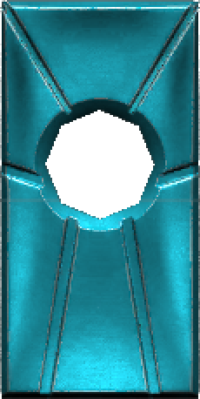
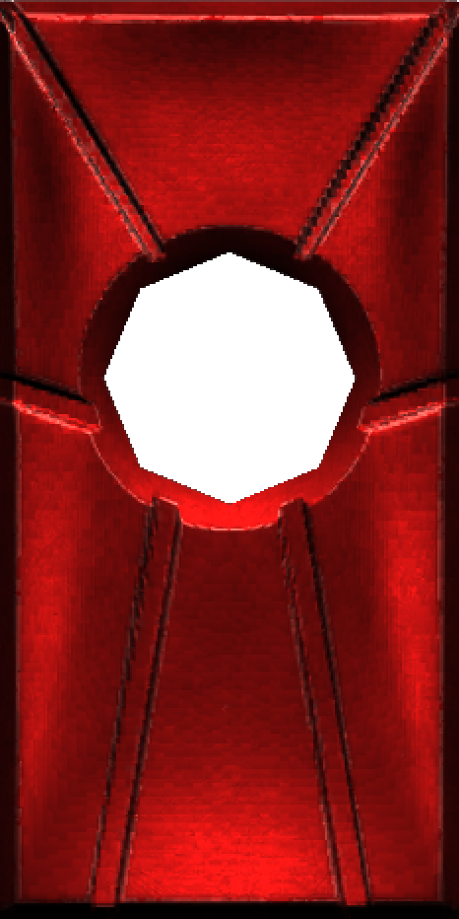
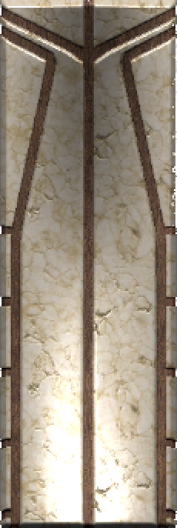
Stone Types
Ice Mage
Pyro
Warrior
Slides once it falls in the falling direction, can pass stairs
Blows up walls that it touches, causes a big shockwave
Can reach farther as well as hit objects like boulders harder

Slide 7

Trailer

Slide 8
Project Plan Part 1: Work Division
 | Prototype | Presentation & Pitch
Alex E | Programming, Debugging | Game design, Story, Trailer
Alex S | Art Modelling | Cost, Break-Even, Marketing, Pricing
Mengdi | Programming, Debugging | Project Plan, Publishing, Trailer
Taieb | Sound Effect

Slide 9
Project Plan Part 2: Platform & Tools
Communication
Face-To-Face
Whatsapp
Discord
Prototype Platform
Unity
Source Control
Github Plug-In for Unity

Slide 10
Project Plan Part 3: Time Estimation
Before our project starts…
 | Estimated Time | Deadline
Idea & Concept | 3 weeks | 20.11.2017 (4th Seminar)
Game Mechanic | 1 week | 27.11.2017 (5th Seminar)
First playable Level | 4 weeks | 24.12.2017 (Chrismas)
All Models added |  | 24.01.2018
All Sound Effect added |  | 24.01.2018
UI finished | 2 weeks | 24.01.2018
All Levels finished | 4 weeks | 25.01.2018
Game Build successful | 1 day | 26.01.2018

Slide 11
Project Plan Part 3: Time Estimation
When it really starts…
 | Finished Time | Overdue?
Idea & Concept | 27.11.2017 | Yes ☹
Game Mechanic | 28.11.2017 | Yes ☹
First playable Level | 05.12.2017 | No ☺
All Models added | 21.12.2017 | No ☺
All Sound Effect added | 22.01.2018 | No ☺
UI finished | 15.01.2018 | No ☺
All Levels finished | 21.01.2018 | No ☺
Game Build successful | 24.01.2018 | No ☹

Slide 12
Project Plan Part 4: Action List (real)
Action | Date | Notes
1. Team Set Up | 23.10.2017 | 1st Seminar
2. New Member | 06.11.2017 | 2nd Seminar
3. Kick-Off 1 | 27.11.2017 | Game Idea confirmed
4. Level Design | 16.01.2018 | Two more Level Designs
5. Trailer | 25.01.2018 | Trailer finished
6. Presentation | 06.03.2018 | Presentation finished

Slide 13
Project Plan Part 5: Milestones (real)
Milestones | Date | Notes
1. Kick-Off 2 | 28.11.2017 | Game mechanic confirmed
2. First Commit | 03.12.2017
3. New Models | 04.12.2017
4. First Test Level | 05.12.2017 | First playable Level
5. Domino Spawn | 07.12.2017 | Drag spawns Domino
6. Edit Mode | 15.12.2017
7. Line Renderer | 15.12.2017 | Spawn shows line
8. Camera Function | 17.12.2017
9. New Domino Type | 18.12.2017 | Ice Domino added

Slide 14
Project Plan Part 5: Milestones (real)
Milestones | Date | Notes
10. Reverse Mechanic | 18.12.2017 | Game Reverse Framework
11. Basic UI | 19.12.2017 | Primary UI added
12. Sound Effect | 21.12.2017
13. UI Refinement | 15.01.2018 | UI finished
14. New Domino Type | 17.01.2018 | Pyro Domino added
15. New Levels | 21.01.2018 | New Designs realized
16. Model Refinement | 22.01.2018 | All Models finished
17. Vibration | 24.01.2018 | Vibration added
18. Project Build | 24.01.2018 | Prototype finished! ☺

Slide 15
Project Plan Part 6: Future
Since our prototype is already finished, we could imagine what if we start up as a real indie team right now?
Team Reinforcement
At least one more dedicated Designer (Artist)
At least two more Programmers
Team Leader (Project Manager)
Nice-To-Have: Assistant (Marketing, Publishing, etc.)

Slide 16
Project Plan Part 6: Future
Imaginary Time Estimation
 | Estimated Time
New Game Concept & Story | 1 week / maybe not
Game Mechanic Refinement | 3 weeks
Target Group Analysis | 1 week
First Test Level | 3 weeks
Game Design Refinement | consecutive
First playable Beta Level | 4 weeks
All Levels playable | 4 weeks
Level Beatufication | 2 weeks
All done before get into Market | ???

